Slide 1
IS 333 A2
Implementing New Enterprise Resource Planning (ERP) System For ANZ Bank
Group 7:
S11219545 - Shamal Prasad
S11219309 - Rudr Prasad
S11221529 - Ahad Ali
S11221067 - Rishal Prasad

Slide 2
Content Outline
Issues with Legacy System
Solution Strategy
Stakeholders
Project Scope
Milestones and Success Criterias
Project Team
Project Timeline
Project Budget
Risk Management
Change Management
Communication Plan

Slide 3
Issues with Legacy System
Fragmented Systems & Data Silos
Data Inconsistency and Inaccuracy
Inefficient HR and Payroll Processing
Poor Customer Service Coordination
Compliance Reporting Delays
Difficulty in Holistic Risk Assessment
Limited Analytics Capabilities

Slide 4


Solution Strategy
Implement an Enterprise Resource Planning System which offers a comprehensive solution for ANZ Bank by integrating various business functions into a single, unified platform.

Slide 5
Stakeholders
Project Team
ANZ Bank Executive Committee
Head Of HR, Accounting, Customer Service, Compliance and Risk Management Departments
ANZ Bank Staff

Slide 6
Project Scope
Objectives:
Implement new system that offers all necessary functionality through central system.
Prevent any data redundancy.
Improve Compliance response time.
Improve Customer Service response time.
More convenient system for payroll processing.
AI driven analytics for better future projections
Limitations & Constraints:
Budget: 250,000 Fijian Dollars
Timeframe: 12 Months
One ERP System with all necessary Modules

Slide 7
Milestones and Success Criterias
Milestone:
Success Criteria:
Elimination of Redundant Data entries
Faster Compliance Reporting
Faster Customer Service
Faster Payroll Processing
Future Projection Analytics
Phase | Deadline
Inception | 4th July 2025
Planning | 26th August 2025
Prototyping | 17th November 2025
Implementation | 23rd January 2026
Testing | 3rd April 2026
Transition | 26th May 2026

Slide 8
Project Team
Name | Role
Rudr Prasad | Project Manager
Rishal Prasad | Business Analyst
Ben Ryan | ERP Consultant
Shamal Prasad | System Engineer
James Charles | Data Analyst
Ahad Ali | QA Engineer
Adam Snow | Training Specialist

Slide 9
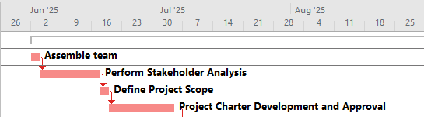
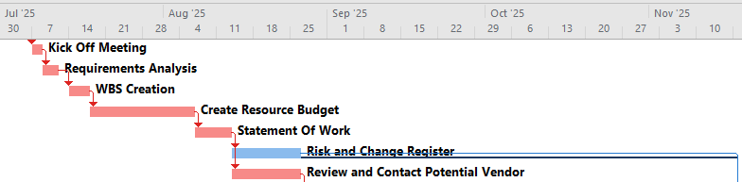
Project Timeline
Inception
Planning

Slide 10
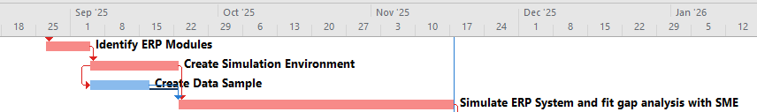
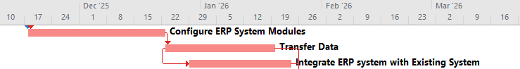
Project Timeline
Prototyping
Implementation

Slide 11
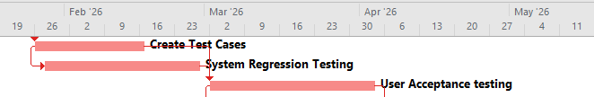
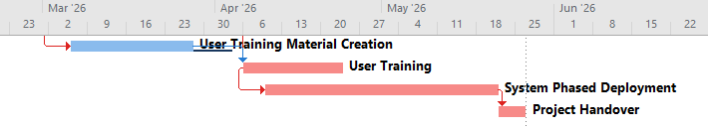
Project Timeline
Testing
Transition

Slide 12
Budget
Testing
Fully Loaded Labour | $17,741.17
Facility | $550.00
Equipment | $895.00
Material | $900.00
Phase Total | $20,086.17
Transition
Fully Loaded Labour | $14,025.22
Facility | $960.00
Equipment | $970.00
Material | $1,475.00
Phase Total | $17,430.22
Total Loaded Labour Cost | $109,101.82
Hardware Cost | $2,500.00
Software Licensing Cost | $133,650.00
Contingency Funds | $4,748.18
Total Cost Of Project | $250,000.00
Summary Budget of ERP System of ANZ Bank
Task | Cost
Inception
Fully Loaded Labour | $5,882.11
Facility | $82.00
Equipment | $40.00
Material | $30.00
Phase Total | $6,034.11
Planning
Fully Loaded Labour | $12,250.32
Facility | $107.00
Equipment | $76.00
Material | $88.00
Phase Total | $12,521.32
Prototyping
Fully Loaded Labour | $20,506.03
Facility | $230.00
Equipment | $1,600.00
Material | $890.00
Phase Total | $23,226.03
Implementation
Fully Loaded Labour | $27,878.98
Facility | $175.00
Equipment | $950.00
Material | $800.00
Phase Total | $29,803.98

Slide 13
Risk Management
Top 3 Main Risks:
ERP Integration Risks: Incompatible systems cause data corruption, crashes, and service disruptions, leading to financial losses and reputational damage.
Vendor Lock-In Risk: Heavy reliance on the ERP vendor results in high costs, slow updates, and limited flexibility, forcing expensive renegotiations or migrations.
Data Security & Compliance Risk: Weak encryption and offshore data storage increase breach risks, leading to fines, legal issues, and loss of customer trust.

Slide 14
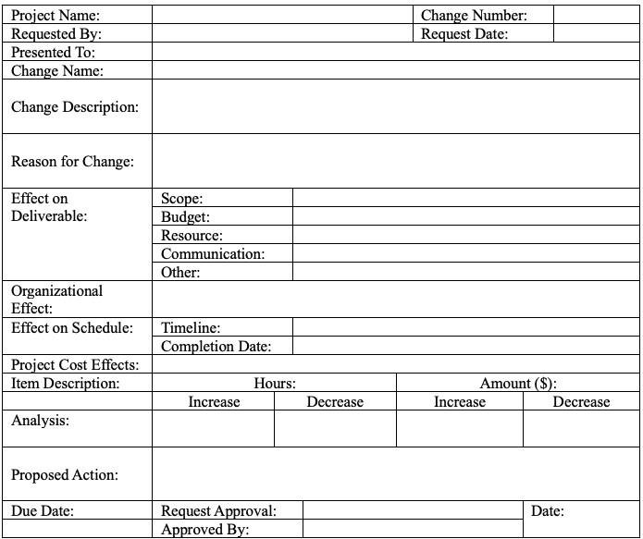
Change Management
General Chain Process:
Request: Submit a detailed change request.
Assessment: A committee evaluates the impact.
Decision: Approve or reject based on analysis.
Implementation: If approved, update plans (WBS, budget, timeline).
Communication: Inform stakeholders of the decision and effects.
Change Request Form Template:

Slide 15
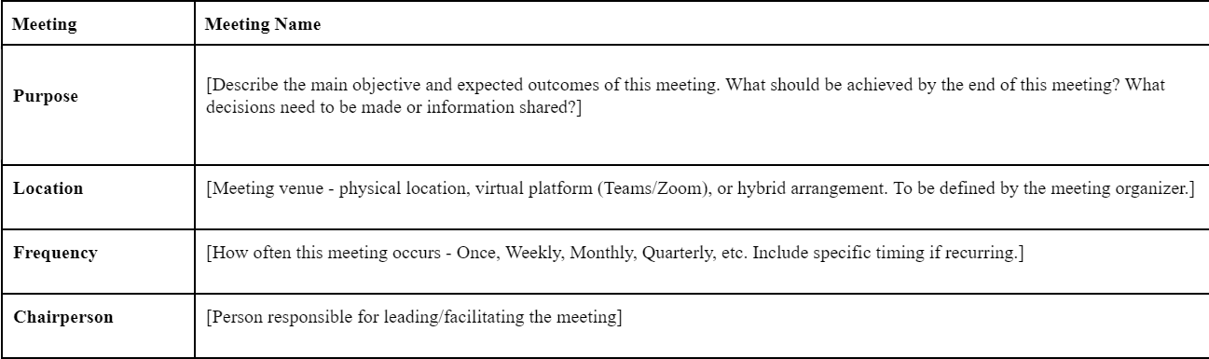
Communication Plan

Slide 16
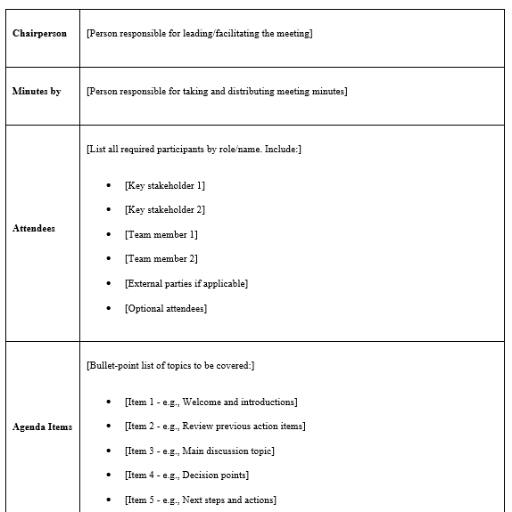

Slide 17
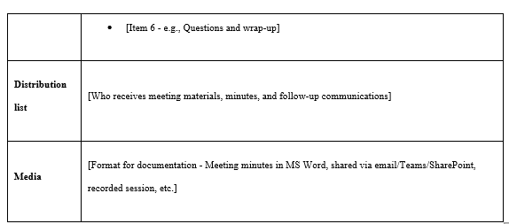

Slide 18
Conclusion
Integrated Approach: The project management plan for ANZ Bank addresses the problems caused by fragmented legacy systems by introducing a structured, integrated ERP solution.
Agile & Stakeholder Focus: Agile techniques and continuous stakeholder engagement ensure the project remains flexible, transparent, and aligned with business needs.
Phased Milestones: Using clear milestones and task assignments helps manage dependencies, reduces bottlenecks, and keeps the project on track.
Communication & Feedback: Regular feedback cycles and a strong communication plan ensure all stakeholders are informed, and lessons learned are incorporated throughout the project.
Recommendations: Prioritize end-user training and change management, maintain proactive risk monitoring, and foster ongoing communication to ensure a smooth transition and long-term success.

Slide 19
Thank You
Any Questions ?

